Slide 1

UXJourney
the
The process to optimize your resource for the quality User Requirement
ISMAIL WAHYU FADILAH
202010370311339
CLASS 7D
W R I T T E N B Y H C I G R O U P

Slide 2
UXJourney
the
The process to optimize your resource for the Requirement quality User
Second Versions
Written by HCI Group
Universitas Muhammadiyah Malang and Universiti putra malaysia
Wahyu Andhyka Kusuma Azrul Hazri bin Jantan Novia Admodisastro Noris Mohd Norowi

Slide 3
UXJourney
the
The process to optimize your resource for the quality User Requirement
The UX journey is a process that helps optimize resources for quality user requirements while improving self-efficacy. The process involves a series of steps that begin with understanding the user's needs and expectations. This includes research to gain insights into the user's goals, motivations, and pain points. Once the user's needs have been identified, the next step is to develop a user persona, which is a detailed description of the user's characteristics, preferences, and behaviors. This persona serves as a reference point throughout the UX design process.
The next step in the UX journey is to define the user journey, which is the user's path to achieving their goals. This includes mapping out the steps involved in the user's interactions with the product or service and identifying potential pain points or areas for improvement.
Once the user journey has been defined, the UX designer can prototype and test different solutions. This involves creating wireframes, mockups, and prototypes of the product or service and testing these designs with users to gather feedback and identify areas for improvement.
Throughout the UX journey, it is important to focus on the user’s needs and expectations and continuously iterate and improve the design based on feedback and testing. By following this process, designers can optimize their resources to deliver quality user requirements while building their self-efficacy and confidence in their design decisions.

Slide 4

Hello
This is my UX Diary
PLACE YOUR
PHOTO
HERE
Tell me about your personality and ability
Hello, I am Ismail Wahyu Fadilah, or commonly called Fadilah. I am a student of Bachelor of Literature 1 Informatics Engineering Program at the University of Muhammadiyah Malang with NIM 202010370311339. I have a great interest in model design techniques, particularly in the context of user experience (UX). I believe that UX plays an important role in producing a more functional, efficient, and satisfying product or system for the end user. I am constantly striving to deepen my knowledge and skills in the UX journey through on-campus learning and also through activities outside the classroom. I am excited to continue contributing to the development of products or systems that can improve the quality of user experience.

Slide 5
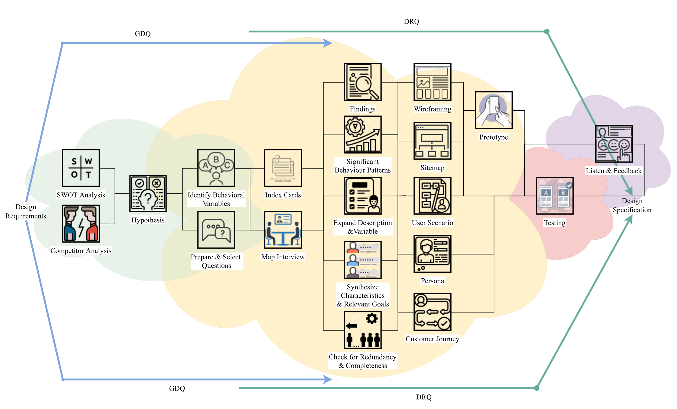
UXJourney
the
The process to optimize your resource for the quality User Requirement

Slide 6
UX Journey Activities Checklist
Activity | Time* | Activity | Time*
(D) Discover |  | Expand the Description of Attributes and Behavior | 4
Field studies | 20 | Persona | 16
SWOT Analysis | 60 | Journey Mapping | 50
Competitor Analysis | 6 | User Scenario and Stories | 13
State hypotheses | 14 | Sitemap | 2
Identify Behavioral Variables | 2 | Wireframing | 16
(E) Explore |  | (T) Test
Prepare Questions | 8 | Quantitative & Qualitative Usability Testing | 12
Meet Stakeholder | 8 | A/B Testing | 30
Index Card | 16 | Objective Verification | 4
Map Interview Subjects to Behavioral Variables | 16 | Variable Verification | 4
Identify Significant Behavior Patterns | 4 | Acceptance Criteria | 45
Synthesize Characteristics and Relevant Goals | 8 | (L) Listen
Check for Redundancy and Completeness | 8 | Follow up | 10
*Time in minutes

Slide 7
My Goals
10
Kickstart Project | Day 1 Study the material to be done on project B and prepare the material to be included in the document | Day 2 Menyelesaikan dan mendikumentasikan personality and ability, UX jurney activities checklist, dan My Goals | Day 3 Complete and document Field STudies, SWOTs, and COmpetitors
Time allocation
Day 4 Complete and document Hypothesis, Identify Behavioral Variable and Prepared Questions | Day 5 Complete documenting meeting stakeholders and findings | Day 6 Complete and document Index Card and Map Interviews | Day 7 Complete and document significant behavior patterns
Day 8 Complete and document synthesize characteristics and check for redundancy | Day 9 Complete and document validation, verification and expand descriptions | Day 10 Complete and document personas, custom journeys, and user scenarios | Day 11 Complete and document site maps, wire framing and qualitatives
Day 12 Complete and document A/B Testing, Verification and objective behavioural variables | Day 13 Complete and document acceptance criteria and follow-up | Day 14 Submitting a Project | Deliver Project

Slide 8



Slide 9
Field studies
20
The MEMLUR application aims to help teenagers recognize interests and talents, guiding them in determining goals or suitable jobs. Research methods include creating user personas through interviews, implementing UX Journeys for effective user experience, as well as literature studies of adolescent developmental psychology and similar applications. Research variables include the introduction of interests, the effectiveness of the career determination process, and the sustainability of application use. The research process involves developing an ENTHRALLING app with interest and talent identification features. User testing is conducted to validate the functionality and effectiveness of the application. Data analysis is carried out by statistical methods to evaluate hypotheses and derive conclusions. The expectation of the results of the study is to provide deep insight into the effectiveness of the MEMURING application in helping adolescents determine the appropriate career. The implications and benefits of research include a positive impact on adolescent career development, providing recommendations for application development, and contributing to practical understanding in the recognition of interests and talents in adolescence.

Slide 10
SWOT analysis
60
Strength
Advantages? | Enabling educational intervention with the latest technology
Uniqueness? | Provide more efficient learning benefits and wort in the scope Maximized time
Selling Points? | Allows them to find their true selves so as not to be confused when determine their work
Skills? | Provide the needs needed in the introduction of talent interests and \ The right learning they like
Other factors? | -
Weaknesses
Limitations? | Not all devices can access this learning application.
Lack of effort? | Requires adequate infrastructure area internet connection
Problems? | The introduction of interest material can only be accessed digitally, so it is not there is a live/offline introduction
Poor strategy? | -
Other factors? | -
Opportunities
Improvements? | The development and application of talent interest recognition technology can can provide new opportunities for innovative application development
Performance? | It can be easy for them to discover their talent interests so as not to wrong when taking a higher level
Opportunities? | -
Consumer behavior? | -
Other factors? | -
Threats
External trouble? | The possibility of a cyber attack due to system vulnerabilities which may cause the app to be inaccessible or interfere with the luring
obstacles? | Enable a digital divide between students who don't have application access with which to have access.
Trends? | -
Other factors? | -

Slide 11
Competitor
6
DIRECT COMPETITION
INDIRECT COMPETITION
Ruang Guru
Quipper
Onsite introduction
USER REVIEWS
Ruang Guru
An online learning platform that provides a variety of learning materials ranging from elementary - high school, which can be accessed through applications or the web.
Advantage:
Have a private tutor who can help students understand the material Complete learning materials adapted to the Indonesian curriculum
Weaknesses:
Constraints in the network
Limited interaction between teachers and students because it is carried out online
2. Quipper
An online learning platform that provides video-based learning materials, practice questions, and online exams. Advantages and disadvantages: Learning materials that are complete and adapted to the Indonesian curriculum, features of question and online exams, some materials are only provided in the form of videos, prices are relatively expensive

Slide 12
Hypotheses
10
HYPOTHESES PERSONAS
EXPLANATION
HPS 1
HPS 2
HPS 3
HPS 4
HPS 5
Sasmita
Zaril
Farzi
Noni
Edang
The use of talent interest recognition applications must be able to increase their interest in learning in the form of more efficient and interesting learning Talent interest recognition applications should be able to assist them in determining their majors more interactively and effectively This application must be able to run smoothly and easily in its application because it uses from all ages This application is expected to have a statistical feature so that they can monitor their results making it easier for them to determine their talent interests A person who is still confused about his talent and confused about finding a job that suits his fashion

Slide 13
Hypotheses Explanation
6
The hypothesis of the persona in the context of the application "ALLURING": Persona: A user who is confused about his talent and looking for a job that matches his interest in fashion. Hypothesis: 1. Improved Majors: By implementing the CAPTIVATING app, we hypothesize that users will experience an improvement in their majoring. The interactivity and effectiveness of the app is expected to help them better explore and identify their interests and talents. 2. Increase Learning Interest: We assume that users will show increased interest in learning, as the app is designed to present more efficient and engaging learning. With a more positive learning experience, it is hoped that they will be more motivated to explore and develop their interests. 3. Ease of Use: This hypothesis states that ease of use of the app will be a key factor. If the application can run smoothly and easily used by users of different age groups, then we believe that this will increase user adoption and satisfaction. 4. Monitoring and Evaluation: This assumption states that the presence of statistical features in the application will provide added value to users. They can monitor their results and progress over time, helping them make more informed decisions related to their interests and talents. By testing and validating this hypothesis through the UX Journey, we hope to gain deeper insights into how users interact with COMPELLING apps and to what extent those apps manage to achieve their desired goals.

Slide 14
Identify Behavioral Variables
2
OBSERVED BEHAVIORAL VARIABLE
SCALE
1Difficulties in the use of the application Learning talent interest is easy to understand Difficulties in the determination of talent interest
(Easy – Hard) (Easy – Hard) (Easy – Hard)

Slide 15
Variable Explanation
6
Developers can ensure the applications created will meet the needs of users better. Improve user experience in running applications.

Slide 16


Slide 17
1 5-minute prepare questions
8
2 Minutes | Welcome Remarks | 1. Asslamu'alaikum, Introduce my name Ismail Wahyu Fadilah, I am a student of UMM Informatics Engineering would like to conduct an interview with you to seek opinions for the application system for ordering masonry services
2 Minutes | Collect demographics | 2. Allow you to introduce yourself first
2 Minutes | Tell a story | 3. As an application developer, I need to ensure that the application is easy to use, as well as provide input from about the shortcomings of the application developed so that the application can be as expected.
2 Minutes | Problem ranking | 4. The following are related to the problems that exist as a user, in your opinion; • What features do you expect from a talent interest recognition app? • What types of assessments and evaluations would you like to see in the recognition app talent interest. • What are the security and privacy issues that need to be considered in the application LURE?
3 Minutes | Explore customer's word view | 5. Related to the use of the application, are there things that make it difficult for users to the application or are there things that might be added to become additional features in the application
2 Minutes | Wrapping up | 6. Maybe that's all for the interview session I did this time, thank you for wanting to be a resource person for the process of making my application system
2 Minutes | Document results | 7. Dokumen hasil wawancara ini digunakan bahan pertimbangan sebelum membuat aplikasi yang lebih baik.

Slide 18
Prepared questions
8
What features do you expect from the PEMIKAT app? What are the obstacles you find in using the PEMIKAT application today? What is the most effective way to convey feedback on learning these talent interests? What types of assessments and evaluations would you like to see in the CHARMER app? Does it need to feature Scores in the testing of each talent? What are the security and privacy issues to be aware of in the CHARMER app?

Slide 19
Creativity is intelligence having fun
Albert Einstein

Slide 20
Meet stakeholder
8
OBJECTIVE AND EXPECTED RESULTS
The purpose of this stakeholder meet is to meet people related to the application such as students who are still looking for their talents and goals where they want to go in determining their goals and work, to explore information about the needs needed to produce appropriate applications.
5 MINUTES QUESTIONS
As a user needs a payment system that supports multiple payment methods commonly used by customers? As users need information such as features, after recognizing interests, talents can recognize the right job? As a user, want to make it easier to use the application to be more efficient in learning, interests, talents, and relevance? As users want the security and privacy of user data to be implemented using the right protocols and security? As a user want this application to be easily accessible and accessible to all users without exception? As a user, you want this application to provide knowledge about potential talent interests in yourself by providing various types of educational learning as interesting as possible?

Slide 21
Findings
8
MENTION YOUR FINDINGS
Most users need a payment system that supports several payment methods commonly used by customers.
MENTION YOUR FINDINGS
Some of the users need information such as features after recognizing interests, talents can recognize the right job
MENTION YOUR FINDINGS
The majority of users want it to be easy to use the application to be more efficient in learning, interests, talents, and relevance.
MENTION YOUR FINDINGS
As a user, this application wants to provide knowledge about the interests of potential talents in themselves by providing various types of educational learning as interesting as possible.

Slide 22





Persona name: Sasmita
16
1. As a user Requires System Payment supports multiple Payment methods commonly used by customer.
2. As a user Require information like the after feature Recognizing Talent Interests can recognize work the right one
3. As the user wants to Easy in Using the App to be more efficient in Talent Interest Learning and relevant.
4. As the user wants to Data Security and Privacy user applied Using the protocol and proper security.
5. As the user wants to The app is easily accessible and accessible by All users without Exception
6. As the user wants to This app gives knowledge of interests Potential talent in yourself with Provides a variety of J Enis Educational Learning as interesting as possible.
Share your idea, write in this notes

Slide 23
Persona name: Zaril
16
1. As a user Requires System Payment supports multiple Payment methods commonly used by customer.
3. As the user wants to Easy in Using the App to be more efficient in Talent Interest Learning and relevant.
4. As the user wants to Data Security and Privacy user applied Using the protocol and proper security.
2. As a user Require information like the after feature Recognizing Talent Interests can recognize work the right one
5. As the user wants to The app is easily accessible and accessible by All users without Exception
6. As the user wants to This app gives knowledge of interests Potential talent in yourself with Provides a variety of J Enis Educational Learning as interesting as possible.
Share your idea, write in this notes

Slide 24
Persona name:
Farzi
16
1. As a user Requires System Payment supports multiple Payment methods commonly used by customer.
2. As a user Require information like the after feature Recognizing Talent Interests can recognize work the right one
3. As the user wants to Easy in Using the App to be more efficient in Talent Interest Learning and relevant.
4. As the user wants to Data Security and Privacy user applied Using the protocol and proper security.
Share your idea, write in this notes

Slide 25
Persona name:
Noni
16
1. As a user Requires System Payment supports multiple Payment methods commonly used by customer.
3. As the user wants to Easy in Using the App to be more efficient in Talent Interest Learning and relevant.
6. As the user wants to This app gives knowledge of interests Potential talent in yourself with Provides a variety of J Enis Educational Learning as interesting as possible.
2. As a user Require information like the after feature Recognizing Talent Interests can recognize work the right one
Share your idea, write in this notes

Slide 26
If a User is having a problem, it's our problem.
Steve Jobs

Slide 27

Map Interview
16
USER FEELING
Persona:
Variable: 1. 1 What I feel is that the application has many payment methods
Scale 1: Not Happy | Scale 2: | Scale 3: Just Normal | Scale 4: | Scale 5: Happy
Respondent: 1. 2. | Respondent: 1. 2. | Respondent: 1. 2. | Respondent: 1. 2. | Respondent: 1. 2.
Variable: 2. What I feel in informing the purpose in talent interest
Scale 1: Not Satisfied | Scale 2: | Scale 3: Just normal | Scale 4: | Scale 5: satisfied
Respondent: 1. 2. | Respondent: 1. 2. | Respondent: 1. 2. | Respondent: 1. 2. | Respondent: 1. 2.

Slide 28
Map Interview
16
USER FEELING
Persona:
Variable: 3. Which I feel in the smoothness given the application
Scale 1: Dificult | Scale 2: | Scale 3: Just normal | Scale 4: | Scale 5: Easy
Respondent: 1. 2. | Respondent: 1. 2. | Respondent: 1. 2. | Respondent: 1. 2. | Respondent: 1. 2.
Variable: 4. What I feel is that user data is guaranteed safe
Scale 1: Dificult | Scale 2: | Scale 3: Just normal | Scale 4: | Scale 5: Easy
Respondent: 1. 2. | Respondent: 1. 2. | Respondent: 1. 2. | Respondent: 1. 2. | Respondent: 1. 2.
Variable: 5. What I felt in his introduction and learning methods
Scale 1: Not Satisfied | Scale 2: | Scale 3: Just normal | Scale 4: | Scale 5: satisfied
Respondent: 1. 2. | Respondent: 1. 2. | Respondent: 1. 2. | Respondent: 1. 2. | Respondent: 1. 2.

Slide 29
Significant Behaviour Patterns
2
OBSERVED BEHAVIORAL VARIABLE
SCALE
PERCENTAGE
What I feel is that the application has many payment methods What I feel in informing the purpose in talent interest Which I feel in the smoothness that the application provides What I feel is that user data is guaranteed safe What do I feel in his introduction and learning methods?
From 5 stakeholders obtained: Scale 2 = 3, Scale 3 = 2 From 5 stakeholders obtained: Scale 1 = 5 From 5 stakeholders obtained: Scale 2 = 5 From 5 stakeholders obtained: Scale 1 = 3, Scale 3 = 2 From 5 stakeholders obtained: Scale 1 = 1, Scale 2 = 4
60%, 40% 0%
100%
100%
60% 40 % 0%
20%, 80% 0%

Slide 30
Pattern Explanation
6
Explain the percentage results from interview results to personas : First variable: 60% of customers feel quite happy and 40% are happy because the application provides many payment methods. Second Variable: 100% of customers feel very happy because the information of talent interests is quite clear Third variable: 100% of customers feel very happy because the application runs smoothly Fourth variable: 60% answered Happy, 40% answered Neutral, 0% answered Not Happy. Fifth variable: 20% of customers feel very happy and 80% happy because the learning method is quite interesting and easy to understand

Slide 31





Synthesize Characteristics And Relevant Goals
8
PATTERN
Persona:
Variable: 1
 | __% | ___% | 40% | ___% | 60%
Variable: 2
 | __% | ___% | __% | ___% | 100%
Variable: 3
 | __% | ___% | __% | ___% | 100%
Variable: 4
 | __% | ___% | 40% | ___% | 60%
Variable: 5
 | ___% | ___% | 80% | ___% | 20%

Slide 32
Synthesize Explanation
14
Based on SYNTHESIS CHARACTERISTIC AND RELEVANT GOAL data, a pattern is obtained The explanation is as follows: Variable 1.60% of customers feel quite happy and 40% are happy because the application provides many payment methods. Significant : Quite happy Variable 2, 100% of customers feel very happy because the information of talent interests is quite clear Significant : Very happy Variable 3, 100% of customers feel very happy because the application runs smoothly Significant : Very happy Variable 4, 60% of customers feel very happy and 40% are happy because the level of application security is guaranteed Significant : Very happy Variable 5, 20% of customers feel very happy and 80% are happy because the learning method is quite interesting and easy to understand Significant : Happy

Slide 33
Want your
users to fall in
love with your
designs? Fall in
love with your users.
Dana Chisnell

Slide 34
Check for Redundancy and Completeness
2
Is there anything missing from the personas mappings, characteristics and objectives that needs to be added?
If so, please specify: No
To satisfy stakeholder assumptions or requests, does any other persona need to be added?
If so, please specify which persona should be added:
Are they any two personas that differ only as to social-demographic variables?
If so, please specify what decision is to be taken:
Remove one of the personas. If so, specify which one:
Examine characteristics more thoroughly and differentiate personas.:
Are all created personas significantly different?
If so, please state which personas are alike:
Overall, are the created personas representative enough of the diversity of real-world behavior and needs?
Yes, because the existing persona has been used to meet the research to explore the respondent

Slide 35
Expand Description and Variable
4
TODAY I AM FEELING...
same day every day, keep going
TODAY I AM GOTING TO...
more efficient and diligent
TODAY I AM LOOKING FORWARD TO...
start everything as usual
MY AFFIRMATION TODAY
Pursue the future as if you still have 1000 years to live and worship as if you have only 1 day left to live

Slide 36
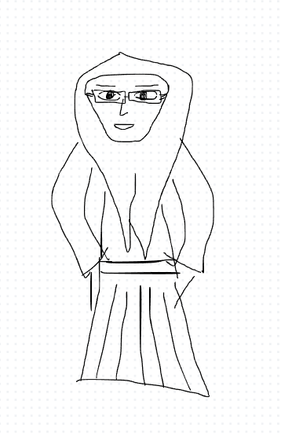
Persona
16
Persona name: Sasmita
Roles & tasks:Teens, Social Media
Age: 15
Profession: Pelajar SMP
User quote:
Continue to be ambitious to be on top
Personality traits/ behaviour: Sosial Media, Vlogger Content, Beauty
Lifestyle:
Motivation: Learn to find yourself and continue flower
Skill & Knowledge:
Novice (browsing, email)
Intermediate (social media)
Proficient (manage website)
Expert (programing complex web)
Authority (publish influential research)
Other Skill & Knowledge:
Segment: Difficulty in finding oneself
Difficulties in determining a career
Difficulty in finding the right thing
Sketch persona:

Slide 37
To create a memorable design, you need to start with a thought that’s worth
remembering.
Thomas Manss

Slide 38




Customer Journey Mapping
50
1
Decide on a target customer persona and the scope of the journey to be explored today.
Give them a visual representation, name and description.
2
Use sticky notes to build a back story, including the customer's reasons for taking this particular journey.
3
Ideally, 1 persona = 1 journey map. Duplicate these pages to repeat the exercise for another persona.
Key Attribute
Short Description
Add your thought here
Sasmita
Children who like to play, learn flexibly, easily and use applications to learn as well as play
Add your thought here
Persona 1 [Insert persona's name here]
Needs
Challenges
Requires a recognizable app His potential with interactive information
Find apps that inform you about His personality, potential, and talents are in himself validly and easily.
Add your thought here
Add your thought here
Opportunities
Add your thought here
We can plan to create an application that can discover the identity of children who are still confused about their potential. In the application will be made as simple as possible and easy so that it can be used by children and all ages.

Slide 39




50
Persona 1
4
Describe the persona's journey in the first 3 rows, using one sticky note per action. "User actions" pertain to activities; "touchpoints" are interaction points like a website or email; and "pain points" refer to frustrations, errors and bottlenecks.
5
In the "emotions" row, move the dots up or down the colored spectrum to visually show how the persona's emotional experience rises and falls throughout the journey. Positive peaks = delight, while sudden drops = frustration.
6
In the final row, brainstorm possible solutions or areas of opportunity to improve the persona's experience.
Awareness
Consideration
Purchase
Onboarding
Advocacy
User Actions
Application Tutorials
App Login/Registration
Choose the talent menu
Potential talent monitor Self
Add your thought here
Add your thought here
Add your thought here
Add your thought here
Add your thought here
Getting Started with the App
Skip" Tutorial
Click Login, fill in the username Passsword
There are various menus
Learning Outcomes talent interest
Touchpoints
Click Apps
Pain points
2x clicks
2x kkil skip and start
To sign in
Can only select Available menu only
Results will come out if have learned and Work with Specified time
D e l i g h t e d
Emotions
F r u s t r a t e d
Possible Solutions

Slide 40
Usability rules the Web. If customers can't find a product, they will not buy it.
Jakob Nielsen

Slide 41
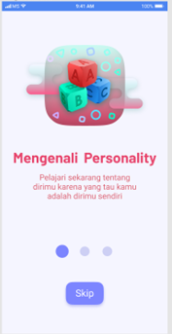
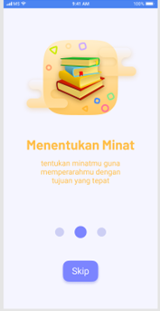
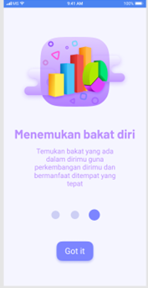
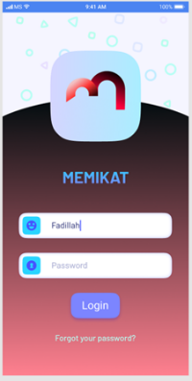
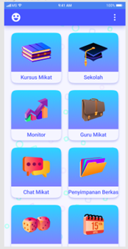
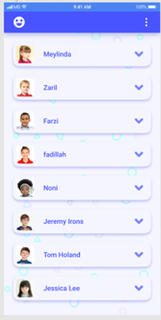
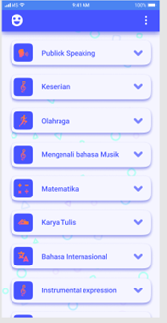
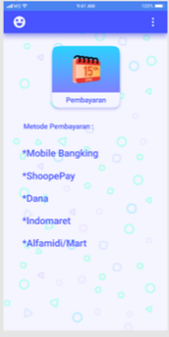
User Scenario and Stories
13
Tutorial, Skip
Tutorial, Skip
Tutorial, Got it
Login/Registration Menu
Users can choose Multiple Learning Menus According to talent interests
Users can see other users and can interact with each other
Users can choose Features in different areas of interest
Users can choose Payment methods

Slide 42
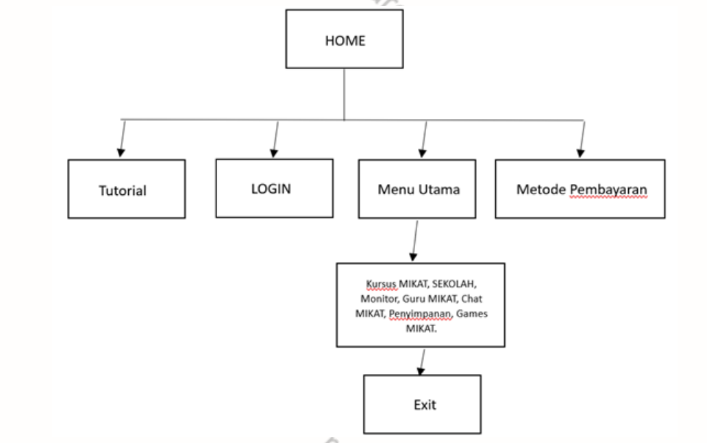
Sitemap
2

Slide 43

Wireframing
16
Screen name:
Menu Login/ Registrasi
Component:
Button
username
Password
Heuristic violated:
Login menu display

Slide 44
Wireframing
16
Screen name:
Main Menu
Component:
Button Various menus
Heuristic violated:
Display various menus

Slide 45
Wireframing
16
Screen name:
Features of Talent Interest
Component:
Button Some Methods of Talent Interest
Heuristic violated:
Kinds Multiple features ask for talent

Slide 46
Wireframing
16
Screen name:
Fitur Pengguna
Component:
Button
Profil Pengguna
Heuristic violated:
Tampilan menu ini dapat melihat
profil pengguna dan dapat saling berinteraksi

Slide 47

Wireframing
16
Screen name:
Payment Methods
Component:
Button Payment Methods multiple Methods*
Heuristic violated:
This view shows the features Payment methods

Slide 48


Slide 49

Qual & Quant
12
QUALITATIVE RESEARCH
QUANTITATIVE RESEARCH
Focus on "why"
Focus on "how many" & "how much"
Inform design decisions
Evaluate the usability of an existing site
Identify usability issuesand find solutions
Track usability over time
Findings based on the researcher’s impressions, interpretations, and prior knowledge
Compare site with competitors
USER REVIEWS
The reason I use quantitative research is because this research can focus deeply on the experience and feature features for users. One of them uses the AB Testing method, which is a method that is suitable for checking learning game systems whose function is to understand experience, identify needs, and as a comparison tool against similar systems with the latest systems based on what is needed by users.

Slide 50
AB Testing
30
Variable: 1
 | 100% | ___% | ___% | ___% | ___%
Variable: 2
 | 80% | ___% | 20% | ___% | ___%
Note:
Note:
Helped by an easy login menu and forgot password feature that users think is enough in the login menu
Because the show menu is not displayed can confuse users when selecting some other menus

Slide 51
AB Testing
30
Variable: 1
 | ___% | ___% | 80% | ___% | 20%
Variable: 2
 | ___% | ___% | 20% | ___% | 80%
Note:
Note:
In this prototype, users are not satisfied because the appearance in this menu is less attractive and the naming
In this prototype, users feel satisfied because they are presented with a menu to see friends and interact with friends

Slide 52
AB Testing
30
Variable: 1
 | 20% | ___% | ___% | ___% | 80%
Note:
In this prototype, users are satisfied because there are many choices of payment methods

Slide 53
Verification
4
PERSONAS
EXPLANATION
HYPOTHESES
H1
H2
H3
H4
H5
Children who like to play, learn
From the results of the system above, if a comparative test is carried out with similar applications, users have enough to feel that this learning education application system is in accordance with what has been expected by users and can function according to its usefulness

Slide 54
Objective Explanation
4
My reason is that the first page is made a simple menu to make it easier for users to direct these users and sometimes there are also users who want to quickly quickly enter this application. For the second page, I immediately display the main menu that has been opened later can be selected class by the user. The third page goes to a sub-class section that can only be used \according to the previous menu that has been opened first. On the fourth page here enter the learning menu. namely questions and questions that must be answered correctly by the user, besides that on this page also displayed additional opportunities to answer the questions given.

Slide 55
Objective Behavioral Variables
4
OBSERVED BEHAVIORAL VARIABLE
SCALE
Ease of obtaining classes that match the user's talent Child's ease of wearing gadgets for talent edukation The child's convenience that determines the child's talent interest in the sub-class of the class that has many options Convenience of a child who is a talent player anytime and anywhere Convenience of getting additional class classes in the class menu
1,2,3,4,5. 90% have been represented by user stories of children who like to learn online

Slide 56
Acceptance Criteria
45
Positive Case
Given | When | Then | User Interface
Login | when kilk got it going open login menu | Application displays the Login display feature Username Type : String & Integer Minimum : 4 characters Maximum : - Character Password Type : String & Integer Minimum : 4 characters Maximum : 12 Characters

Slide 57
Acceptance Criteria
45
Positive Case
Given | When | Then | User Interface
Main Menu | Show the menu main when kilk login | Main Menu Mikat Course Type : Integer School Type : Integer Monitor Type : Integer Teachers are alluring Type : Integer Captivating Chat Type : Integer File storage Type : Integer

Slide 58
Acceptance Criteria
45
Positive Case
Given | When | Then | User Interface
Features of Interest Talent | After Click the menu Main view Here are the features of talent | Showcase the Talent Interest feature Inchies Public Speaking Type : Integer Art Type : Integer Sport Type : Integer

Slide 59
Acceptance Criteria
45
Positive Case
Given | When | Then | User Interface
Method payment | This feature is the menu Payments with using a variety of Specified methods | Payment methods Mobile Bangking Type : Integer ShoopePay Type : Integer Funds Type : Integer Indomaret Type : Integer Alfamidi/Mart Type : Integer

Slide 60


Slide 61
Follow up
10
In this application that we have developed this is in accordance with what is needed by users such as the existence of additional payment methods. With all these features, users are expected to be able to take advantage of the application and can attract some users to use this system. After conducting further observations and analysis with users, they also still need a system that can interact with other talent scouts as well.

Slide 62

UXJourney
the
The process to optimize your resource for the quality User Requirement
From Developer for Developer

